Slide 1
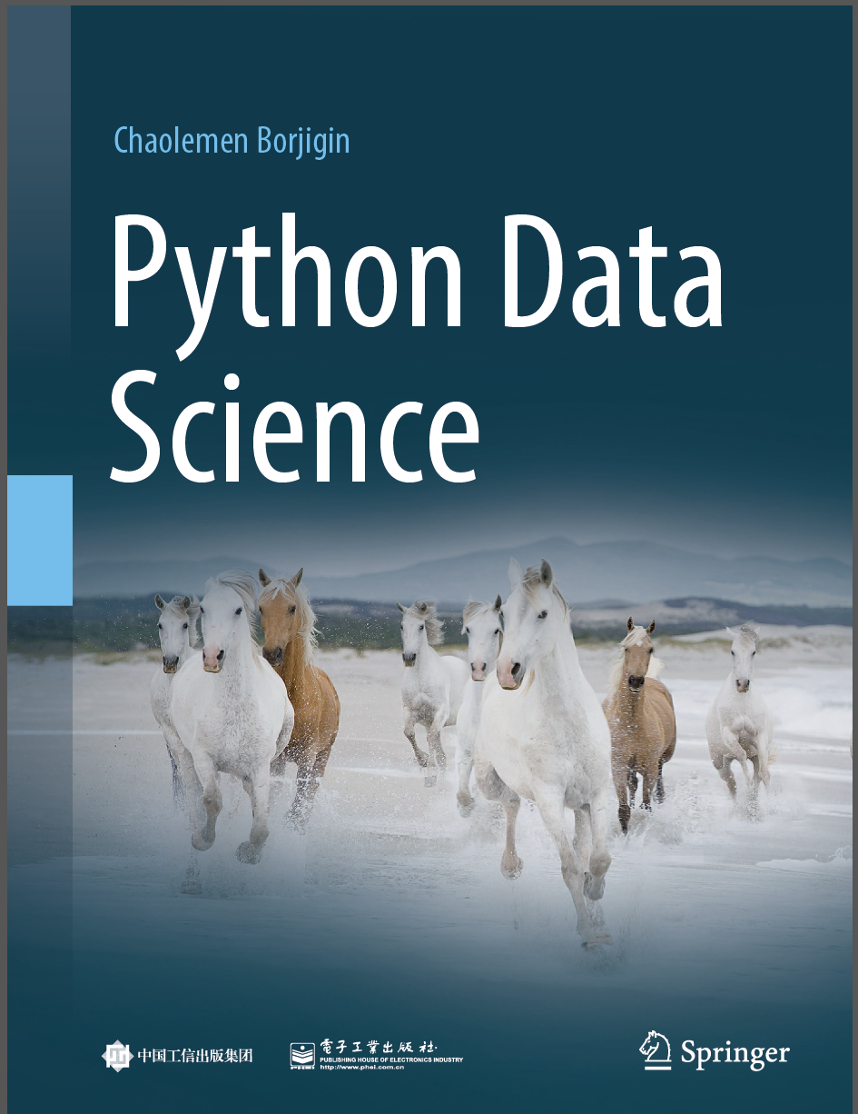
Python Data Science
Chaolemen Borjigin
  Renmin University of China
  chaolemen@ruc.edu.cn

Slide 2
2.14 Sets
▼ Chapter 2 Basic Python Programming for Data Science
► 2.14 Sets
Chaolemen Borjigin
  Renmin University of China
  chaolemen@ruc.edu.cn

Slide 3
Summary of this chapter
▼ Chapter 2 Basic Python Programming for Data Science
► 2.14 Sets
2.14.1 Defining sets
2.14.2 Main features
2.14.3 Basic operations
2.14.4 Sets and data science

Slide 4
2.14.1 Defining sets
▼Chapter 2 Basic Python Programming for Data Science
► 2.14 Sets
In[1]:
mySet1={1,2,3,4,1,2,23}
mySet1
Out[1]:
{1, 2, 3, 4, 23}
In[2]:
mySet2=mySet1
mySet2
Out[2]:
{1, 2, 3, 4, 23}

Slide 5
2.14.1 Defining sets
▼Chapter 2 Basic Python Programming for Data Science
► 2.14 Sets
In[3]:
myList1=[1,2,3,3,2,2,1,1]
mySet3=set(myList1)
mySet3
Out[3]:
{1, 2, 3}
In[4]:
mySet4=set("chaolemen")
mySet4
Out[4]:
{'a', 'c', 'e', 'h', 'l', 'm', 'n', 'o'}

Slide 6
2.14.2 Main features
▼Chapter 2 Basic Python Programming for Data Science
► 2.14 Sets
In[5]:
2 in mySet3
Out[5]:
True

Slide 7
2.14.2 Main features
▼Chapter 2 Basic Python Programming for Data Science
► 2.14 Sets
In[6]:
mySet4[2]
---------------------------------------------------------------------------
TypeError Traceback (most recent call last)
<ipython-input-6-78241c857f8a> in <module>
----> 1 mySet4[2]
TypeError: 'set' object is not subscriptable

Slide 8
2.14.2 Main features
▼Chapter 2 Basic Python Programming for Data Science
► 2.14 Sets
In[7]:
mySet5={1,2,3}
mySet6={1,2,1,1,3}
mySet5==mySet6
Out[7]:
True

Slide 9
2.14.3 Basic operations
▼Chapter 2 Basic Python Programming for Data Science
► 2.14 Sets
In[8]:
mySet7={1,3,5,10}
mySet8={2,4,6,10}
In[9]:
3 in mySet7
Out[9]:
True
In[10]:
3 not in mySet7
Out[10]:
False

Slide 10
2.14.3 Basic operations
▼Chapter 2 Basic Python Programming for Data Science
► 2.14 Sets
In[11]:
mySet7 == mySet8
Out[11]:
False
In[12]:
mySet7 != mySet8
Out[12]:
True
In[13]:
{1,5} < mySet7
Out[13]:
True

Slide 11
2.14.3 Basic operations
▼Chapter 2 Basic Python Programming for Data Science
► 2.14 Sets
In[14]:
mySet7|mySet8
Out[14]:
{1, 2, 3, 4, 5, 6, 10}
In[15]:
mySet7&mySet8
Out[15]:
{10}
In[16]:
mySet7-mySet8
Out[16]:
{1, 3, 5}

Slide 12
2.14.3 Basic operations
▼Chapter 2 Basic Python Programming for Data Science
► 2.14 Sets
In[17]:
mySet7^mySet8
Out[17]:
{1, 2, 3, 4, 5, 6}
In[18]:
print({1,3}.issubset(mySet7))
True
In[19]:
print({1,3,2,4}.issuperset(mySet7))
False

Slide 13
2.14.3 Basic operations
▼Chapter 2 Basic Python Programming for Data Science
► 2.14 Sets
In[20]:
mySet9={1,2,3,4}
mySet9.add(4)
mySet9.remove(1)
mySet9
Out[20]:
{2, 3, 4}

Slide 14
2.14.3 Basic operations
▼Chapter 2 Basic Python Programming for Data Science
► 2.14 Sets
In[21]:
mySet10=frozenset({1,2,3,4})
mySet10
Out[21]:
frozenset({1, 2, 3, 4})

Slide 15
2.14.3 Basic operations
▼Chapter 2 Basic Python Programming for Data Science
► 2.14 Sets
In[22]:
mySet10.add(5)
---------------------------------------------------------------------------
AttributeError
Traceback (most recent call last)
<ipython-input-22-d051a89f1878> in <module>
----> 1 mySet10.add(5)
AttributeError: 'frozenset' object has no attribute 'add'

Slide 16
2.14.4 Sets and data science
▼Chapter 2 Basic Python Programming for Data Science
► 2.14 Sets
In[23]:
myList=["d","a","t","a"]
mySet11=set(myList)
mySet11
Out[23]:
{'a', 'd', 't'}

Slide 17


